Slide 1

Simple Models, Lots of Data:
Mining semantics about entities using Web-Scale Data
Kaushik Chakrabarti
Joint International Workshop on Entity-oriented and Semantic Search (JIWES) 2012 @ SIGIR Conference

Slide 2
Computers Doing Complex Tasks
Today, computers are doing complex, “human” tasks
  Machine translation
  Speech recognition
  Computer Vision
  Spelling correction
  Web Ranking
  Spam Filtering
  Entity Semantics Mining
  …
No neat, concise algorithms ☹
  Cannot be explained by neat formulas like F=ma
  Or elegant algorithm like Dijkstra’s shortest path algorithm

Slide 3
Initial attempts: Using algorithms, rules and heuristics
Machine translation:
  Hand-coded rules that capture underlying structure of language
Speed recognition:
  Rules, heuristics and signal processing tricks
Named entity recognition
  Hand-crafted grammars by experienced computation linguists
…

Slide 4
Initial attempts: Using algorithms, rules and heuristics
Not driven by data
Why?
  Belief: human intelligence can be encapsulated in algorithms and hand-crafted rules
  Data was not available, computers did not have capacity (kilobytes of memory, megabytes of disk)

Slide 5
Emergence of Data-driven systems
Machine translation:
  Large training set of input-output pairs available
  Initially, data-driven systems were worse (till early 2000s)
  Rapid progress in quality: getting better with more training data, already exceeds best rule-based systems
  Can expand to new domains rapidly
Speech recognition:
  Large training sets available
  Initially, data-driven methods (HMMs) were worse (till late 1980s)
  Rapid progress in quality with more training data; have become the norm

Slide 6
Outline of talk
Entity semantics Mining
Earlier efforts
Data-driven approaches
  Case Study 1: Entity synonyms
  Case Study 2: Entity attribute discovery
  Case Study 3: Entity augmentation
  Case Study 4: Entity linking
  Case Study 5: Entity tagging
Outlook and challenges

Slide 7

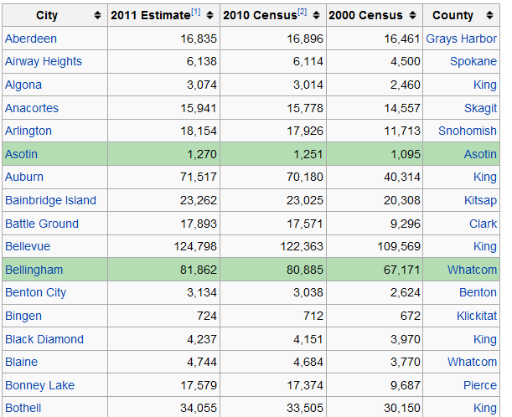
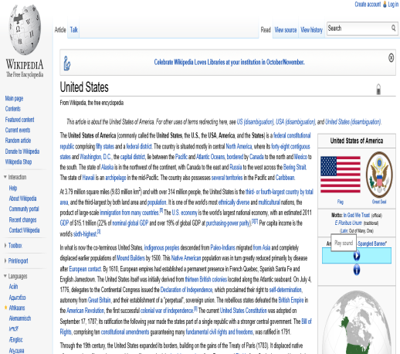

Why mine semantics about entities?
Entities are everywhere
Data:
  Most data on the web and inside the enterprise are about entities
  Product catalogs in e-tailers
  Tables on the web
  Tables within an enterprise
  Knowledgebases (Wikipedia, Freebase)
  …
Tasks:
  Most consumer and enterprise tasks are about entities
  Searching for products, movies, places, hotels, restaurants, ….
  Business Data Analysis
  Social Media Analytics
  …

Slide 8
Examples of Entity Semantics Mining
Given an entity (or set of entities), what are other ways it is referred to?
  Entity Synonyms
Given a set of entities, what are the interesting attributes of these entities?
  Entity Attribute Discovery
Given a set of entities and an attribute, what are values of the entities on that attribute?
  Entity Augmentation
Given a set of entities and a text corpus, what are the semantic mentions of the entity in the corpus?
  Entity Linking
Given a set of entities, find phrases (“tags”) describing those entities?
  Entity Tagging

Slide 9
Outline of talk
Entity semantics Mining
Earlier efforts
Data-driven approaches
  Case Study 1: Entity synonyms
  Case Study 2: Entity attribute discovery
  Case Study 3: Entity augmentation
  Case Study 4: Entity linking
  Case Study 5: Entity tagging
Outlook and challenges

Slide 10
Earlier Efforts Towards Entity Semantics
Entity recognizers
  Hand-crafted rules by experience computational linguists
Entity synonyms
  Manually discovered by domain-experts
Entity information gathering (attribute discovery, augmentation)
  Writing wrappers for specific web sites
Not data driven: used rules, heuristics rather than data

Slide 11
Outline of talk
Entity semantics Mining
Earlier efforts
Data-driven approaches
  Case Study 1: Entity synonyms
  Case Study 2: Entity attribute discovery
  Case Study 3: Entity augmentation
  Case Study 4: Entity linking
  Case Study 5: Entity tagging
Outlook and challenges

Slide 12
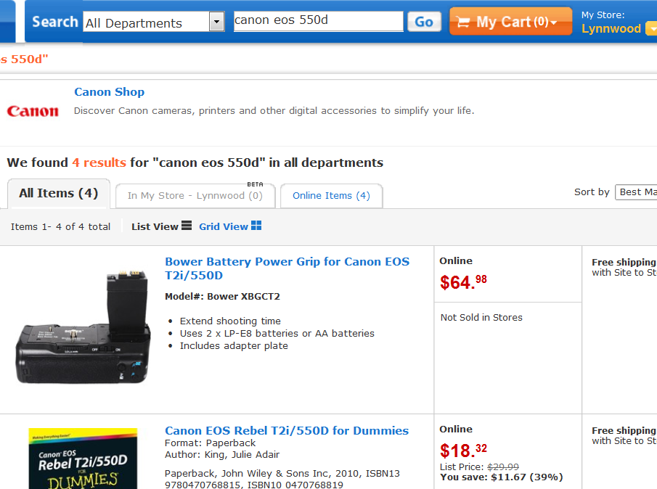
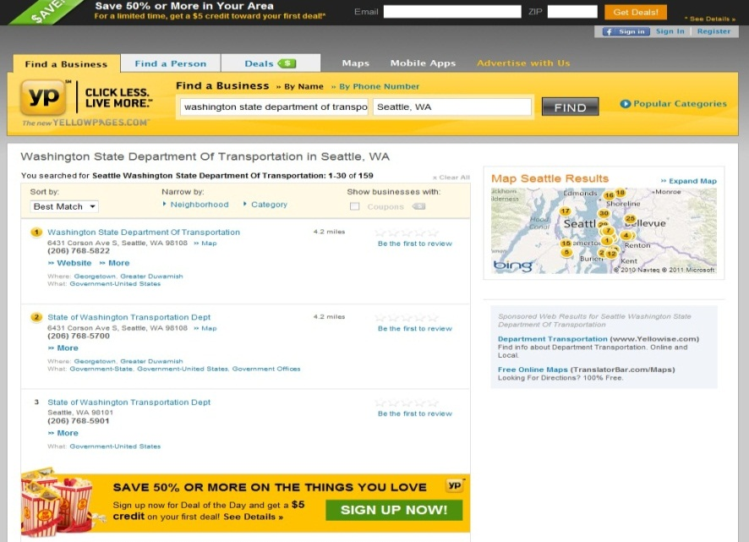
Why entity synonyms?
Users search for entities:
  E-tailers like Walmart:
      allow users to search for products
  Information providers like YellowPages:
      allow users to search for local businesses
  Online music stores like iTunes and Zune Marketplace:
      allow users to search for songs/albums/artists

Slide 13
Why entity synonyms?
Powered by enterprise search engines like FAST and Endeca
Users refer to the same entity in many different ways
Entity | Alternative ways to refer to that entity
canon 400d | canon rebel xti, cannon 400d
harry potter and the half blood prince | harry potter 6, half blood prince, harry potter and the half blooded prince
washington state department of licensing | wa dol, dol washington, wa dmv, wash state dept of licensing
university of washington | uw, uofw, univ of wa, univ of washington
Without this knowledge, search fails to return relevant results
  Bad user experience, loss of web site conversions and sales, customer attrition
Cannot treat them as strings, need to capture semantic relationship

Slide 14
Discovering Synonyms
Previous approach: domain experts provide synonyms manually
  Tedious, costly: e-tailers have thousands, even millions of entities
  New entities keep coming, old entities get obsolete, hard to keep up
Main Insight:
  Search engine’s query click log captures this => if two different search queries refer to same entity, signiﬁcant overlap among the links clicked for the two queries.
  Can we leverage it to find synonyms automatically?
  Requirements:
    Domain independent, high quality, scalable algorithm

Slide 15
Step 1: Generation of Candidate Synonyms
Candidate Synonyms
Clicked Urls
microsoft excel
microsoft word
Entity
http://office.microsoft.com/en-us/excel/
excel spreadsheet
microsoft excel
http://en.wikipedia.org/wiki/Microsoft_Excel
Query
http://blogs.office.com/b/microsoft-excel
ms excel tutorial
ms office

Slide 16
Step 2: Filtering of Candidate Synonyms
Look for strong semantic relationship in both directions
  Filter out candidates that are weakly related
    “microsoft word”
  Filter out candidates that are not exclusively related
    “ms office”
microsoft word
http://office.microsoft.com/en-us/excel/
excel spreadsheet
microsoft excel
http://en.wikipedia.org/wiki/Microsoft_Excel
Query
http://blogs.office.com/b/microsoft-excel
ms excel tutorial
ms office

Slide 17


Not good enough: Click log sparsity
microsoft spreadsheet
$$d_{1}$$
microsoft excel
ms excel
$$d_{2}$$
ms spreadsheet
Pseudo-document similarity (“A Framework for Robust Discovery of Entity Synonyms”, KDD 2012)

Slide 18
Not good enough: Not of same semantic type
“microsoft excel” and “ms excel tutorial” are very strongly related but not of the same “type”
  Software vs. tutorial
A synonym (of an entity) should be
  Strongly related in both directions (measured by pseudo document similarity)
  Of the same type

Slide 19
Context Similarity
Intuition
  If X and Y are entities of the same type, X and Y are exchangeable under various contexts
Where to find contexts?
  Query logs
Examples
  microsoft excel help⬄ ms spreadsheet help ⬄ powerpoint help
  microsoft excel download⬄ ms spreadsheet download ⬄ powerpoint download

Slide 20
Construct Context Vectors
Entities and candidates
microsoft excel
Entities/ Candidates | Contexts
microsoft excel | download
microsoft excel | help
microsoft excel | review
ms spreadsheet | download
ms spreadsheet | help
ms excel tutorial | class
ms excel tutorial | ppt
ms spreadsheet
ms excel tutorial
Other Queries
microsoft excel download
microsoft excel help
microsoft excel
ms spreadsheet download
ms spreadsheet help
ms excel tutorial class
ms excel tutorial ppt

Slide 21


Same type => High Context Similarity
Context from query log
microsoft excel
download, help, review, install, …
ms spreadsheet
download, help, install, …
ms excel tutorial
class, ppt, guide, …
ms spreadsheet
True Synonym

Slide 22
Not good enough: Long entity names
Canon EOS 350D - digital camera,
8MP, 3x Optical Zoom
Entity
Query

Slide 23
Summary
Lots of data available anyway
  Similar to machine translation, speech recognition
  The main insight is how to connect the problem with that data
Insight is important, algorithms are relatively simple
  A classifier with less than 10 features
  Achieves ~90% precision, ~3 synonyms per entity for products
Taking care of details important for high accuracy
  Click log sparsity, context similarity, long entity names
  Need to scale to large query logs
    MapReduce implementation
Further details: “A Framework for Robust Discovery of Entity Synonyms”, KDD 2012

Slide 24
Outline of talk
Entity semantics Mining
Earlier efforts
Data-driven approaches
  Case Study 1: Entity synonyms
  Case Study 2: Entity attribute discovery
  Case Study 3: Entity augmentation
  Case Study 4: Entity linking
  Case Study 5: Entity tagging
Outlook and challenges

Slide 25
Information gathering
Need to gather information for entities to make a decision
  Consumer space:
    Research for products (say, cameras, cars, appliances)
    Research for stocks
    ….
  Enterprise space:
    Information workers, business data analytics
    Application developers, mashup creators
Mostly manual today, very labor intensive
  Can we automate it?
  Semantic task: need to understand entities, attributes and values, not just strings

Slide 26
3 APIs for Information Gathering
Augmentation By Attribute Name (ABA)
Augmentation By Example (ABE)
Attribute Discovery (AD)
Model | Brand
S80
A10
GX-1S
T1460
S80 | Nikon
A10 | Canon
GX-1S
T1460
S80
A10
GX-1S
T1460
Input
Query Table
Model | Brand
S80 | Nikon
A10 | Canon
GX-1S | Samsung
T1460 | Benq
S80 | Nikon
A10 | Canon
GX-1S | Samsung
T1460 | Benq
brand | make | manufacturer | mfr
resolution | mp | megapixel | res
price | retail price | offer
zoom | optical zoom
Output Table

Slide 27
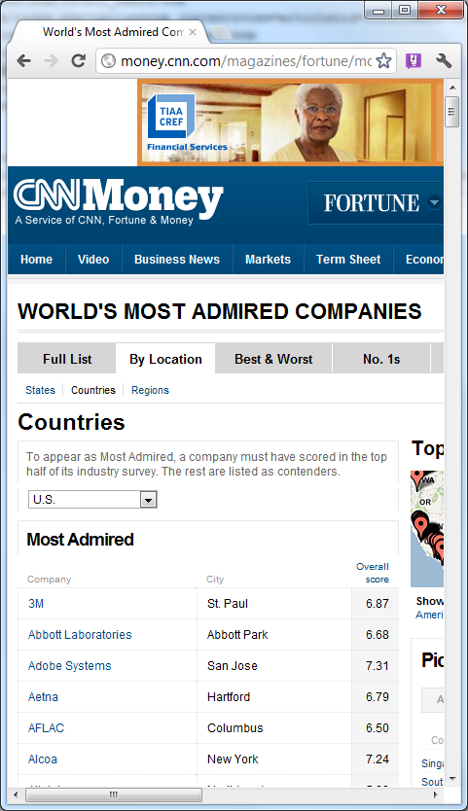
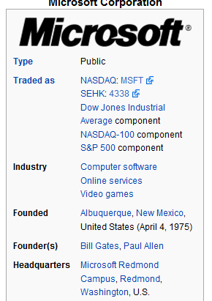
Main Insight
Tables on the web have a lot of structured information about entities and their attributes
Can we leverage it?
This data is available anyway
  Similar to machine translation, speech recognition, entity synonyms
  The main insight is to connect the problem with that data

Slide 28
Initial focus
Focus on relational tables
  Details in paper:
    “InfoGather: Entity Augmentation and Attribute Discovery By Holistic Matching with Web Tables”, SIGMOD 2012

Slide 29
Model | Brand
S80 | Nikon
Easyshare CD44 | Kodak
DSC W570 | Sony
Optio E60 | Pentax
Query Table
0.25
Model | Brand
S80
A10
GX-1S
T1460
Model | Brand
SP 600UZ | Olympus
DSC W570 | Sony
GX-1S | Samsung
A10 | Canon
0.5
Model | Brand
S80 | Benq
A10 | Innostream
A460 | Samsung
S710 | HTC
0.5

Slide 30
Model | Brand
S80 | Nikon
Easyshare CD44 | Kodak
DSC W570 | Sony
Optio E60 | Pentax
Query Table
0.25
Model | Brand
S80
A10
GX-1S
T1460
Model | Brand
SP 600UZ | Olympus
DSC W570 | Sony
GX-1S | Samsung
A10 | Canon
0.5
Model | Brand
S80 | Benq
A10 | Innostream
A460 | Samsung
S710 | HTC
0.5

Slide 31
Model | Brand
S80 | Nikon
Easyshare CD44 | Kodak
DSC W570 | Sony
Optio E60 | Pentax
Query Table
0.25
Model | Brand
S80 | Benq
A10
GX-1S
T1460
Model | Brand
SP 600UZ | Olympus
DSC W570 | Sony
GX-1S | Samsung
A10 | Canon
0.5
Model | Brand
S80 | Benq
A10 | Innostream
A460 | Samsung
S710 | HTC
0.5

Slide 32
Model | Brand
S80 | Nikon
Easyshare CD44 | Kodak
DSC W570 | Sony
Optio E60 | Pentax
Query Table
0.25
Model | Brand
S80
A10
GX-1S
T1460
Model | Brand
SP 600UZ | Olympus
DSC W570 | Sony
GX-1S | Samsung
A10 | Canon
0.5
Model | Brand
S80 | Benq
A10 | Innostream
A460 | Samsung
S710 | HTC
0.5

Slide 33
Model | Brand
S80 | Nikon
Easyshare CD44 | Kodak
DSC W570 | Sony
Optio E60 | Pentax
Query Table
0.25
Model | Brand
S80
A10 | Innostream
GX-1S
T1460
Model | Brand
SP 600UZ | Olympus
DSC W570 | Sony
GX-1S | Samsung
A10 | Canon
0.5
Model | Brand
S80 | Benq
A10 | Innostream
A460 | Samsung
S710 | HTC
0.5

Slide 34
Model | Brand
S80 | Nikon
Easyshare CD44 | Kodak
DSC W570 | Sony
Optio E60 | Pentax
Query Table
0.25
Model | Brand
S80
A10
GX-1S
T1460
Model | Brand
SP 600UZ | Olympus
DSC W570 | Sony
GX-1S | Samsung
A10 | Canon
0.5
Model | Brand
S80 | Benq
A10 | Innostream
A460 | Samsung
S710 | HTC
0.5

Slide 35
Model | Brand
S80 | Nikon
Easyshare CD44 | Kodak
DSC W570 | Sony
Optio E60 | Pentax
Query Table
0.25
Model | Brand
S80
A10
GX-1S | Samsung
T1460
Model | Brand
SP 600UZ | Olympus
DSC W570 | Sony
GX-1S | Samsung
A10 | Canon
0.5
Model | Brand
S80 | Benq
A10 | Innostream
A460 | Samsung
S710 | HTC
0.5

Slide 36
Direct Matching
Approach (DMA)
Model | Brand
S80 | Nikon
Easyshare CD44 | Kodak
DSC W570 | Sony
Optio E60 | Pentax
Query Table
0.25
Model | Brand
S80 | Benq
A10 | Innostream
GX-1S | Samsung
T1460
Model | Brand
SP 600UZ | Olympus
DSC W570 | Sony
GX-1S | Samsung
A10 | Canon
0.5
Model | Brand
S80 | Benq
A10 | Innostream
A460 | Samsung
S710 | HTC
0.5

Slide 37
Model | Brand
S80 | Nikon
Easyshare CD44 | Kodak
DSC W570 | Sony
Optio E60 | Pentax
Part No | Mfg
DSC W570 | Sony
T1460 | Benq
Optio E60 | Pentax
S8100 | Nikon
0.5
Query Table
0.25
0.5
Indirect matching
table
Model | Brand
S80 | Benq
A10 | Innostream
GX-1S | Samsung
T1460
Model | Brand
SP 600UZ | Olympus
DSC W570 | Sony
GX-1S | Samsung
A10 | Canon
0.25
0.5
0.2
Model | Brand
S80 | Benq
A10 | Innostream
A460 | Samsung
S710 | HTC
0.5

Slide 38
Model | Brand
S80 | Nikon
Easyshare CD44 | Kodak
DSC W570 | Sony
Optio E60 | Pentax
Part No | Mfg
DSC W570 | Sony
T1460 | Benq
Optio E60 | Pentax
S8100 | Nikon
0.5
Query Table
0.25
0.5
Model | Brand
S80 | Benq
A10 | Innostream
GX-1S | Samsung
T1460 | Benq
Model | Brand
SP 600UZ | Olympus
DSC W570 | Sony
GX-1S | Samsung
A10 | Canon
0.25
0.5
0.2
Model | Brand
S80 | Benq
A10 | Innostream
A460 | Samsung
S710 | HTC
0.5

Slide 39
T₁
Model | Brand
S80 | Nikon
Easyshare CD44 | Kodak
DSC W570 | Sony
Optio E60 | Pentax
Part No | Mfg
DSC W570 | Sony
T1460 | Benq
Optio E60 | Pentax
S8100 | Nikon
0.5
Query Table
0.25
0.5
Model | Brand
S80 | Benq
A10 | Innostream
GX-1S | Samsung
T1460 | Benq
T₂
Model | Brand
SP 600UZ | Olympus
DSC W570 | Sony
GX-1S | Samsung
A10 | Canon
0.25
0.5
T₃
0.2
Model | Brand
S80 | Benq
A10 | Innostream
A460 | Samsung
S710 | HTC
0.5

Slide 40
Model | Brand
S80 | Nikon
Easyshare CD44 | Kodak
DSC W570 | Sony
Optio E60 | Pentax
Part No | Mfg
DSC W570 | Sony
T1460 | Benq
Optio E60 | Pentax
S8100 | Nikon
0.5
Query Table
0.25
0.5
Model | Brand
S80 | Benq Nikon
A10 | InostreamCanon
GX-1S | Samsung
T1460 | Benq
Model | Brand
SP 600UZ | Olympus
DSC W570 | Sony
GX-1S | Samsung
A10 | Canon
0.25
0.5
0.2
Model | Brand
S80 | Benq
A10 | Innostream
A460 | Samsung
S710 | HTC
0.5

Slide 41
How to model holistic match?
Topic Sensitive Pagerank

Slide 42
Data Model
Query Table
Model | Brand
S80
A10
GX-1S
T1460
Entity-Attribute Binary (EAB) relations
The Query table is an EAB relation
Web tables are split into EAB relations
  URL, title, context retained
Model | Res
S80 | 14.1mp
Easyshare CD44 | 12mp
DSC W570 | 16.1
Optio E60 | 10.1
Web Table
Model | Brand | Res | Optical Zoom
S80 | Nikon | 14.1mp | 5x
Easyshare CD44 | Kodak | 12mp | 3x
DSC W570 | Sony | 16.1 | 5x
Optio E60 | Pentax | 10.1 | 3x
Model | Brand
S80 | Nikon
Easyshare CD44 | Kodak
DSC W570 | Sony
Optio E60 | Pentax
Model | Optical Zoom
S80 | 5x
Easyshare CD44 | 3x
DSC W570 | 5x
Optio E60 | 3x

Slide 43
Augmentation Framework
2 steps:
  Identify Matching Tables
  Predict Values Using Matching Tables

Slide 44
Problem to solve: Holistic matching of EAB Tables
Nodes = EAB tables
Edges = Semantic Similarity
Query Table
0.25
0.5
0.5
Directly matching EAB tables = Topic nodes
DMA Scores = Preference Scores (β)

Slide 45
T₁
Model | Brand
S80 | Nikon
Easyshare CD44 | Kodak
DSC W570 | Sony
Optio E60 | Pentax
T₄
Part No | Mfg
DSC W570 | Sony
T1460 | Benq
Optio E60 | Pentax
S8100 | Nikon
0.5
0.25
Query Table
0.5
Model | Brand
S80
A10
GX-1S
T1460
T₂
Model | Brand
SP 600UZ | Olympus
DSC W570 | Sony
GX-1S | Samsung
A10 | Canon
0.5
0.2
0.5
T₃
Model | Brand
S80 | Benq
A10 | Innostream
A460 | Samsung
S710 | HTC

Slide 46
Summary
Heavy use of preprocessing:
  Compute full personalized pagerank (FPPR) of semantic similarity graph upfront
  Compute TSP scores on the fly
Scalability is a huge challenge:
  How to build the SS graph?
    > 1billion nodes
  How to compute FPPR?
    Use algorithm from Bahmani et. al. (SIGMOD 2011)
Leveraging huge amount of data available anyway
  As in MT, Speech Recognition
Insight is important, algorithms are relatively simple
Details in paper: “InfoGather: Entity Augmentation and Attribute Discovery By Holistic Matching with Web Tables”, SIGMOD 2012

Slide 47
Outline of talk
Entity semantics Mining
Earlier efforts
Data-driven approaches
  Case Study 1: Entity synonyms
  Case Study 2: Entity attribute discovery
  Case Study 3: Entity augmentation
  Case Study 4: Entity linking
  Case Study 5: Entity tagging
Outlook and challenges

Slide 48
Entity Linking Problem
Given a “catalog” of entities and a set of documents, find mentions of those entities in those documents
  Many applications
  Main problem is identify true mentions among candidate mentions (refer it to as “targeted disambiguation”)
Candidate Mentions
d1
Microsoft’s new operating system, Windows 8, is a PC operating system for the tablet age …
Target entities
Entity Id | Entity Name
e1 | Microsoft
e2 | Apple
e3 | HP
d2
Microsoft and Apple are the developers of three of the most popular operating systems
d3
Apple trees take four to five years to produce their first fruit…
CEO Meg Whitman said that HP is focusing on Windows 8 for its tablet strategy
d4
Audi is offering a racing version of its hottest TT model: a 380 HP, front-wheel …
d5
Notes:
So the problem is defined like this. We are given a set of target entities, e1,e2,e3 and their names. We are also given the documents containing the entity names, from d1 to d5. Each (entity, document) pair is called a candidate mention. These are the input of the problem. What is the output?

Slide 49
Existing solutions
Solutions exist when entity catalog is “rich” with description about each entity
  Wikipedia
What if these entities are enterprise entities?
  Not in Wikipedia, referred to as “ad hoc entities”
  Documents can be enterprise documents or web documents
Again, leverage the data!
  Assume the entities in the catalog are homogeneous (of the same “type”)

Slide 50
Insight – leverage homogeneity (1)
Context Similarity
Microsoft’s new operating system, Windows 8, is a PC operating system for the tablet age …
  Similar
Microsoft and Apple are the developers of three of the most popular operating systems
Apple trees take four to five years to produce their first fruit…
CEO Meg Whitman said that HP is focusing on Windows 8 for its tablet strategy
Audi is offering a racing version of its hottest TT model: a 380 HP, front-wheel …
Notes:
The first clue is that the context similarity between true mentions and false mentions will present some different patterns. If we compare the context of any pair of mentions, a general impression is the context of two true mentions are usually more similar than false mentions. For example, these two are context of true mentions about Microsoft and Apple, and they share the same key words operating systems. These two are about Microsoft and HP and they share Windows 8 and tablet. But between this true mention of Microsoft and Apple, and this false mention of Apple, their context is quite different. Also, for these two false mentions of Apple and HP, their context is also different.

Slide 51
Insight – leverage homogeneity (1)
Context Similarity
Microsoft’s new operating system, Windows 8, is a PC operating system for the tablet age …
Microsoft and Apple are the developers of three of the most popular operating systems
  Similar
Apple trees take four to five years to produce their first fruit…
CEO Meg Whitman said that HP is focusing on Windows 8 for its tablet strategy
Audi is offering a racing version of its hottest TT model: a 380 HP, front-wheel …
Notes:
These two are about Microsoft and HP and they share Windows 8 and tablet. But between this true mention of Microsoft and Apple, and this false mention of Apple, their context is quite different. Also, for these two false mentions of Apple and HP, their context is also different.

Slide 52
Insight – leverage homogeneity (1)
Context Similarity
Microsoft’s new operating system, Windows 8, is a PC operating system for the tablet age …
  Dissimilar
Microsoft and Apple are the developers of three of the most popular operating systems
Apple trees take four to five years to produce their first fruit…
CEO Meg Whitman said that HP is focusing on Windows 8 for its tablet strategy
Audi is offering a racing version of its hottest TT model: a 380 HP, front-wheel …
Notes:
But between this true mention of Microsoft and Apple, and this false mention of Apple, their context is quite different. Also, for these two false mentions of Apple and HP, their context is also different.

Slide 53
Insight – leverage homogeneity (1)
Context Similarity
Microsoft’s new operating system, Windows 8, is a PC operating system for the tablet age …
Microsoft and Apple are the developers of three of the most popular operating systems
Apple trees take four to five years to produce their first fruit…
  Dissimilar
CEO Meg Whitman said that HP is focusing on Windows 8 for its tablet strategy
Audi is offering a racing version of its hottest TT model: a 380 HP, front-wheel …
Notes:
Also, for these two false mentions of Apple and HP, their context is also different.

Slide 54
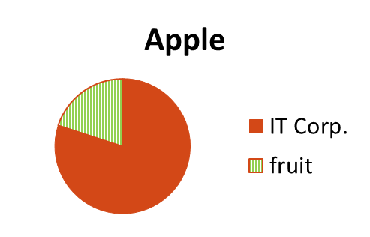
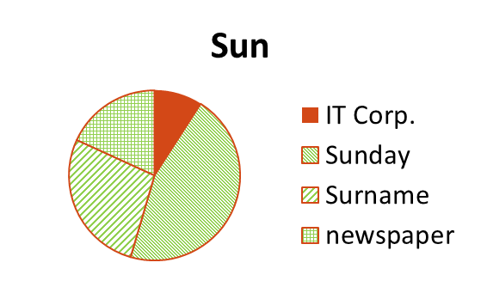
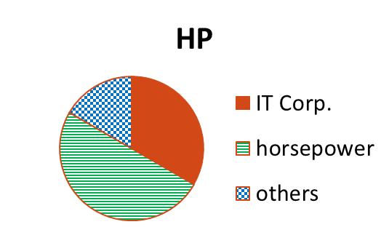
Insight – leverage homogeneity (1)
Hypothesis:
context between two true mentions (of any entities) is more similar than between two false mentions (of distinct entities) as well as between a true mention and a false mention
Detail: the context of false mentions can be similar among themselves within an entity
Notes:
So, what hypothesis can we make about context similarity? in general we can say the true mentions across all the entities across all the documents will have more similar contexts than the false mentions of different entities.
The distribution of entity meanings is skewed and varies from entity to entity
But hopefully, different entities have ambiguous meanings in different domains! (different colors)
And the targeted meanings have similar contexts! (orange color)

Slide 55
Insight – leverage homogeneity (2)
Co-mention
Microsoft’s new operating system, Windows 8, is a PC operating system for the tablet age …
  High confidence
Microsoft and Apple are the developers of three of the most popular operating systems
Apple trees take four to five years to produce their first fruit…
CEO Meg Whitman said that HP is focusing on Windows 8 for its tablet strategy
Audi is offering a racing version of its hottest TT model: a 380 HP, front-wheel …
Notes:
The second clue is more straightforward to understand. If multiple target entity names co-occur in a document, like this one, then due to homogeneity, we should have more confidence that this is a true mention, if we do not have other clues.

Slide 56
Insight – leverage homogeneity (3)
Interdependency
Microsoft’s new operating system, Windows 8, is a PC operating system for the tablet age …
  True
Microsoft and Apple are the developers of three of the most popular operating systems
Apple trees take four to five years to produce their first fruit…
CEO Meg Whitman said that HP is focusing on Windows 8 for its tablet strategy
Audi is offering a racing version of its hottest TT model: a 380 HP, front-wheel …
Notes:
Finally, we can leverage the interdependency of the disambiguation of different mentions to perform holistic disambiguation of all the mentions. For example, if we know this is the true mention from the co-mention clue.

Slide 57
Insight – leverage homogeneity (3)
Interdependency
Microsoft’s new operating system, Windows 8, is a PC operating system for the tablet age …
  True
  True
Microsoft and Apple are the developers of three of the most popular operating systems
Apple trees take four to five years to produce their first fruit…
CEO Meg Whitman said that HP is focusing on Windows 8 for its tablet strategy
Audi is offering a racing version of its hottest TT model: a 380 HP, front-wheel …
Notes:
Finally, we can leverage the interdependency of the disambiguation of different mentions to perform holistic disambiguation of all the mentions. For example, if we know this is the true mention from the co-mention clue.
Then we find its context is similar to this mention, so we guess this is a true mention as well.

Slide 58
Insight – leverage homogeneity (3)
Interdependency
Microsoft’s new operating system, Windows 8, is a PC operating system for the tablet age …
  True
  True
Microsoft and Apple are the developers of three of the most popular operating systems
Apple trees take four to five years to produce their first fruit…
  True
CEO Meg Whitman said that HP is focusing on Windows 8 for its tablet strategy
Audi is offering a racing version of its hottest TT model: a 380 HP, front-wheel …
Notes:
Finally, we can leverage the interdependency of the disambiguation of different mentions to perform holistic disambiguation of all the mentions. For example, if we know this is the true mention from the co-mention clue.
Then we find its context is similar to this mention, so we guess this is a true mention as well, due to the context similarity hypothesis.
Later we find the newly inferred true mention has similar context with this one, so we also consider it’s a true mention.

Slide 59
Insight – leverage homogeneity (3)
Interdependency
Microsoft’s new operating system, Windows 8, is a PC operating system for the tablet age …
  True
  True
Microsoft and Apple are the developers of three of the most popular operating systems
  False
Apple trees take four to five years to produce their first fruit…
  True
CEO Meg Whitman said that HP is focusing on Windows 8 for its tablet strategy
  False
Audi is offering a racing version of its hottest TT model: a 380 HP, front-wheel …
Notes:
Finally, we can leverage the interdependency of the disambiguation of different mentions to perform holistic disambiguation of all the mentions. For example, if we know this is the true mention from the co-mention clue.
Then we find its context is similar to this mention, so we guess this is a true mention as well, due to the context similarity hypothesis.
Later we find the newly inferred true mention has similar context with this one, so we also consider it’s a true mention.
Finally, we find the other mentions have dissimilar context with the true mentions, and we predict they are false mentions. That’s the intuitive idea how we can leverage the context similarity, the co-mention and the interdependency to solve this challenging problem. Now we briefly show how we use a graph-based ranking model to incorporate all these ideas.

Slide 60
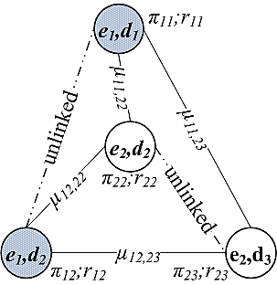
Modeling using Graph (MentionRank)
Prior score of each candidate mention: co-mention
Edge weight: context similarity
Interdependency modeling using PageRank-style propagation
Notes:
. We have some prior estimate pi_ij for r_ij; and we also have the weight mu on each edge. A larger mu means a stronger dependency.
You can find in the paper how we calculate the context similarity and the co-mention prior. Basically we take a short context window of each occurrence of the entity name, and compute tf-idf similarity for every pair of such contexts, and then take the average. That’s not the only way of computing the context similarity and more advanced features can surely be planted into our model.

Slide 61
Summary
Using content in the documents to solve hard problem
Insights are important, algorithms are simple
Scalability is a huge challenge
Further details: “Targeted Disambiguation of Ad-hoc, Homogeneous Sets of Named Entities”, WWW 2012

Slide 62
Outlook and Challenges
Mining semantics of entities is critical
  Both on the web and within the enterprise
  E.g., entity synonyms, entity attribute discovery, entity augmentation, entity linking
  Many, many more problems like this…
Lots of data on the web, within the enterprise
  Leverage the data!
Main challenges:
  Not complex algorithms
  But connecting the desired semantics with the right data (“Statistical Semantics”)
  And scalability (terabytes of query log, billions of web pages, 100s of millions of web tables, etc.)

Slide 63






Tao Cheng
Kaushik Chakrabarti
Kris Ganjam
Zhimin Chen
Vivek Narasayya
Surajit Chaudhuri
Thank you!

